Slide 1
CSE101-Lec#6-Part-1
Control structures(Decision control statements/ or Condition Statements)

Slide 2
Program Development Tools
Algorithm
Flow chart
Pseudo-code

Slide 3
Algorithm
Algorithm is defined as “ the finite set of steps, which provide a chain of action for solving a problem”
It is step by step solution to given problem.
Well organized, pre-arranged and defined textual computational module

Slide 4
Characteristics of good Algorithm
Correctness - terminates on ALL inputs (even invalid inputs!) and outputs the correct answer.
Simplicity - each step of the algorithm performs one logical step in solving the problem.
Precision - each step of the algorithm is unambiguous in meaning.
Comprehensibility - the algorithm is easy to read and understand.
Abstraction - presents the solution steps precisely and concisely without referring to low-level (program code) details.
Efficient - Gives results rapidly based on the problem size; does not waste any space or time.
Easy to Implement - relatively easy to translate into a programming language.

Slide 5
Quick look
How many characteristics we have seen for algorithm just now?
6
7
8
9

Slide 6
Algorithm: Add 2 Numbers
Problem: To add two numbers.
Step1. Start.
Step2. Take the two numbers.
Step3. Add them.
Step4. Print the result.
Step5. Stop.

Slide 7
Pseudocode
Pseudocode is similar to everyday English language, its convenient and user friendly.
It’s not a actual computer programming language.
Pseudocode consist only of action statements
In pseudocode representation
  Each of steps will be written via operators and statements equivalent to some programming language instructions.
  The only difference will be that the exact syntax of the programming language will not be followed.

Slide 8
Pseudo code: Add 2 Numbers
Set A = 4.
Set B = 2.
Calculate Sum = A + B.
Print Sum.

Slide 9
Flow Chart
Flow Chart is pictorial representation of an algorithm.
Whatever we have done in algorithm we can represent it in picture.
It is easy to understand.
Shows the flow of the instruction

Slide 10
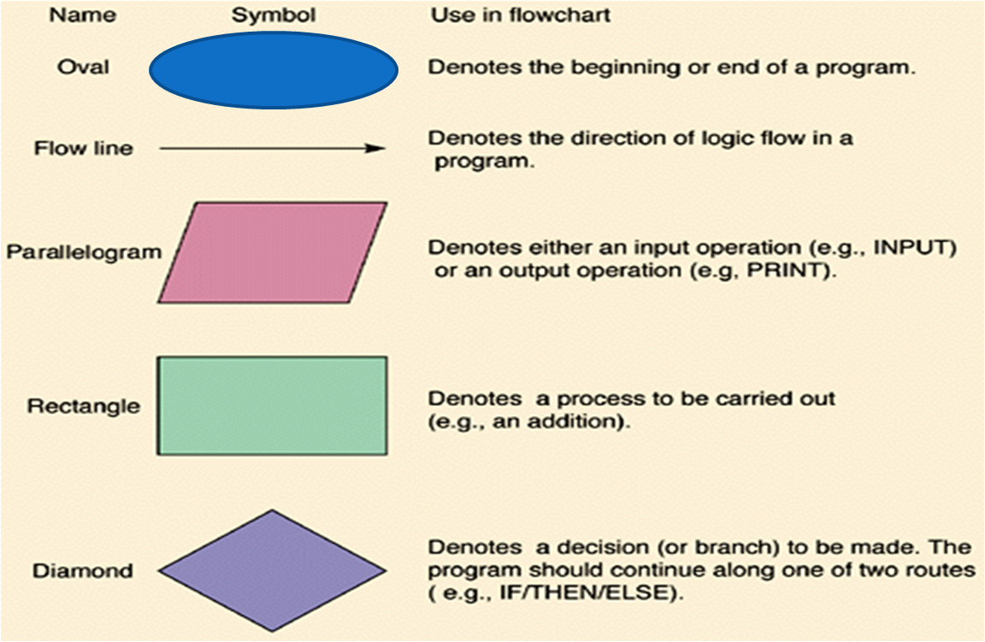
Flow Chart Symbols

Slide 11
Flow Chart: Add 2 Numbers
START
TAKE TWO NUMBERS A and B
FIND SUM=A+B
PRINT SUM
STOP

Slide 12
Program in C: Add 2 Numbers
#include<stdio.h>
void main()
{
int a=4;
int b= 2;
int sum;
sum=a+b;
printf(“Sum is: %d”, sum);
}
Sum is: 6

Slide 13
Program in C
#include<stdio.h>
#include<conio.h>
int main()
{
int pr_per_kg = 45;
float no_of_kg = 7.5;
float t_pr;
t_pr = pr_per_kg * no_of_kg;
printf(“%f”, t_pr);
getch();
}
337.5

Slide 14
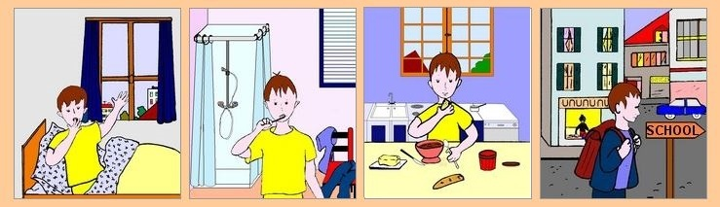

Program
Program is a set of instruction executed one by one.
Depending upon the circumstances sometimes it is desirable to alter the sequence of execution of statements.
1. Wake up;
2. Get ready;
3. If you have enough time, then eat breakfast;
4. Go to school.

Slide 15
Control Statements
The C language programs until now follows a sequential form of execution of statements.
C language provides statements that can alter the flow of a sequence of instructions.
These statements are called control statements.
These statements help to jump from one part of the program to another. The control transfer may be conditional or unconditional.

Slide 16
Control Structure
A control structure refers to the way in which the programmer specifies the order of executing the statements.
Three control structures
  Sequence structure
    Programs are executed sequentially by default.
  Selection structures(Condition)
    if, if…else, if-else-if, Nested-if ,switch
  Repetition structures (iteration)
    while, do…while, for
Notes:
Sequence- all statements are executed in the order as it is written
Selection- Different sets of statements are executed based on one or more conditions
Iteration- Certain set of statements are executed repeatedly

Slide 17
Condition Statements(or Decision control statements or Branching statements)
The C condition statements or the decision statements, checks the given condition
Based upon the state of the condition, a sub-block is executed.
Decision statements are the:
  if statement
  if-else statement
  If-else-if statement
  Nested if statement
  switch statement

Slide 18
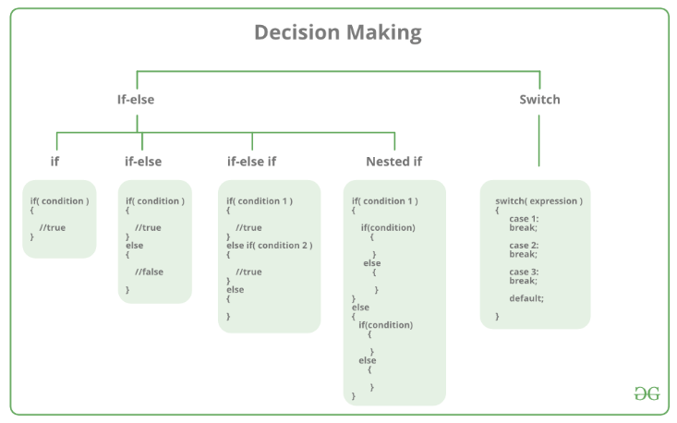

Slide 19


Daily routine
Start
Go!!!
Where
To
Go?
Class
Movie
Stop
Stop

Slide 20
if statement
Yes
If you have time?
No

Slide 21
if Statement
If statement
  It is decision making statement uses keyword if.
  It allows the computer to evaluate the expression first
    and then, depending on whether the value is ‘true’ or ‘false’, i.e. non zero or zero it transfers the control to a particular statement.
A decision can be made on any expression.
zero - false
nonzero - true
Example:
3 < 4 is true

Slide 22
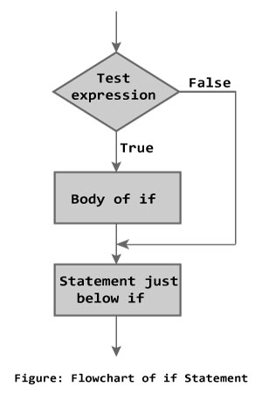
if Statement
Syntax
if (expression)
statement;
or
if (expression)
{
block of statements;
}

Slide 23
if Statement
The if statement has the following syntax:
The condition must be a
boolean expression. It must
Evaluate to either non-zero or zero.
if is a C
reserved word
if ( condition )/* no semi-colon */
statement;
If the condition is non-zero, the statement is executed.
If it is zero, the statement is skipped.

Slide 24


Rain ???
Is it going to rain?
Look up sky for clouds
yes
Clouds?
no
No rain
Raining

Slide 25
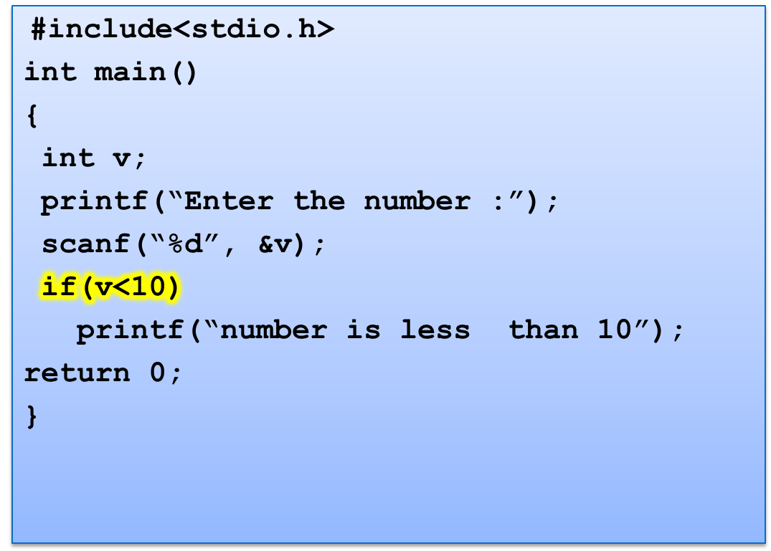
Program to check whether number is less than 10.
Enter the number: 6
Number is less than 10

Slide 26
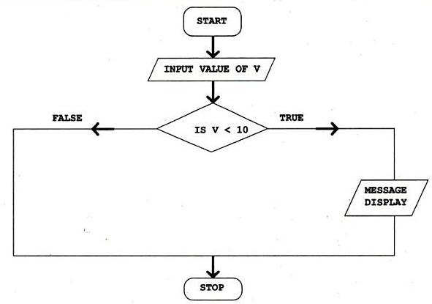
Control Flow

Slide 27
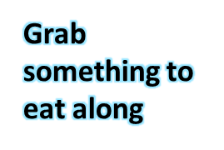

if..else statement
Yes
If you have time?
No

Slide 28
if..else statement
The if statement executes only when the condition following if is true.
It does nothing when the condition is false.
The if..else statement takes care of the true and false conditions.

Slide 29
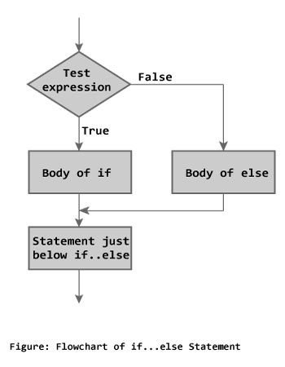
if..else statement
if..else has two blocks.
One block is for if and it is executed when condition is non-zero(true).
The other block is of else and its executed when condition is zero (false).
if (expression)
{
block of statements;
}
else
{
block of statements;
}
Syntax

Slide 30
if..else statement
The else statement cannot be used without if.
No multiple else statements are allowed with one if.
else statement has no expression.
Number of else cannot be greater than number of if.

Slide 31
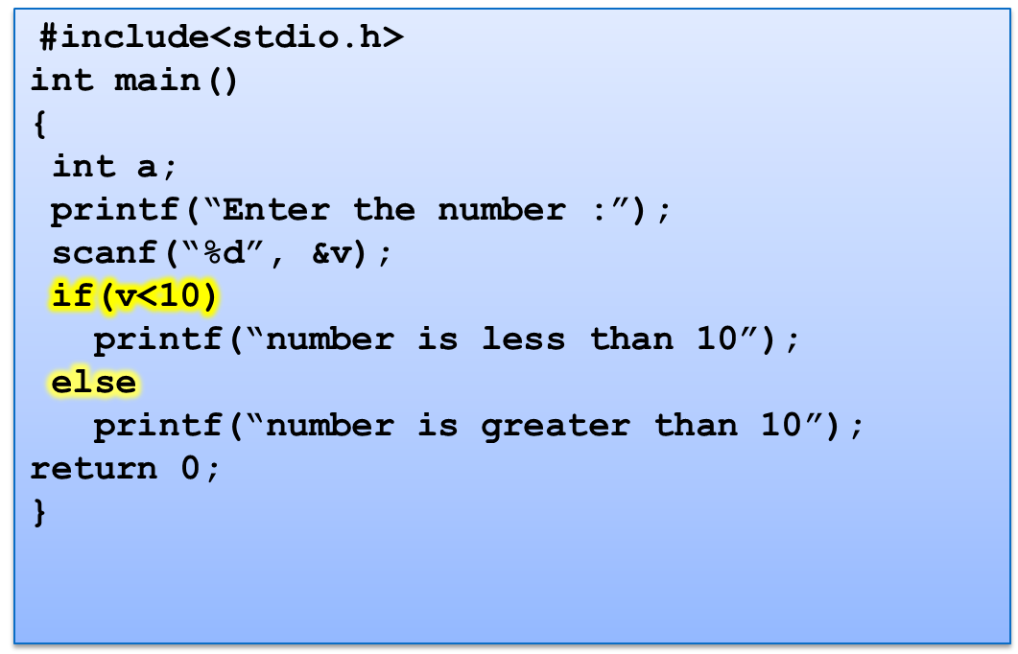
Example : Program to check whether number is less than 10.
Enter the number: 7
Number is less than 10
or
Enter the number: 100
Number is greater than 10

Slide 32
Control Flow
MESSAGE
DISPLAY

Slide 33
Q1
What will be the output of the following C code?
#include <stdio.h>
int main()
{
int x = 5;
if (x < 1)
printf("hello");
if (x == 5)
printf("hi");
else
printf("no");
return 0;
}
A. hi
B. hello
C. no
D. error

Slide 34
Q2
What will be the output of the following C code?
#include <stdio.h>
int main()
{
int x = 0;
if (x == 0)
printf("hi");
else
printf("how are u");
printf("hello");
return 0;
}
A. hi
B. how are you
C. hello
D. hihello

Slide 35
If-else-if
if-else-if statement is used when program requires more than one test expression.
We can check multiple conditions, and what so ever condition is true, that part will work
Here, a user can decide among multiple options.
The C if statements are executed from the top down. As soon as one of the conditions controlling the if is true, the statement associated with that if is executed, and the rest of the C else-if ladder is bypassed. If none of the conditions are true, then the final else statement will be executed.

Slide 36
If-else-if ladder
if ( condition ) {
block of statements;
}
else if ( condition ) {
block of statements; }
else {
block of statements;
}
Syntax

Slide 37
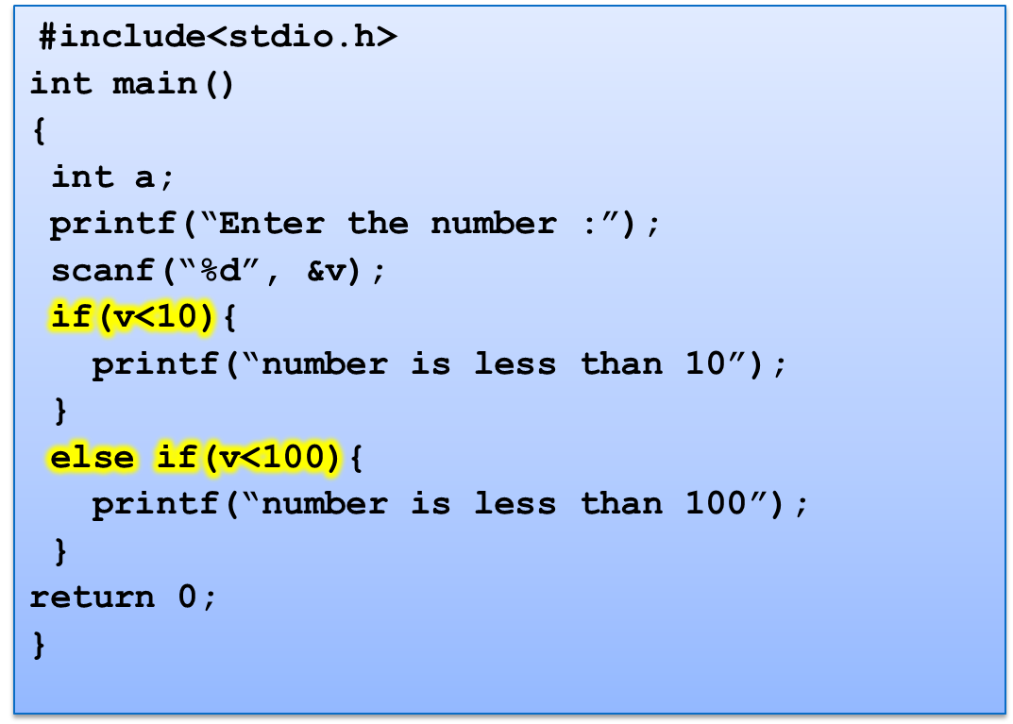
Program to check whether number is less than 10.
Enter the number: 1
Number is less than 10
or
Enter the number: 56
Number is less than 100

Slide 38
Program to print grades of students marks.
#include<stdio.h>
int main()
{
float marks;
scanf(“%f”, &marks);
if (marks>90){
printf(“Grade A”);
}
else if (marks>80) {
printf(“Grade B”);
}
else if(marks>70){
printf(“Grade C”);
}
else if (marks >60) {
printf(“Grade D”);
}
return 0;
}
66.70
Grade D
or
78.00
Grade C

Slide 39
Q1
#include <stdio.h>
int main()
{
int x = 1;
if (x > 0)
printf("inside if\n");
else if (x > 0)
printf("inside elseif\n");
}
A. inside if
B. inside elseif
C. inside if
inside elseif
D. Compile time error

Slide 40
Nested if
A nested if in C is an if statement that is the target of another if statement.
Nested if statements means an if statement inside another if statement.
C allows us to nested if statements within if statements, i.e, we can place an if statement inside another if statement.

Slide 41
Syntax
if (condition1)
{
// Executes when condition1 is true
if (condition2)
{
// Executes when condition2 is true
}
}

Slide 42
Program example
// C program to illustrate nested-if statement
#include <stdio.h>
int main()
{
int i = 10;
if (i == 10)
{
if (i < 15)
printf("i is smaller than 15\n");
if (i < 12)
printf("i is smaller than 12 too\n");
else
printf("i is greater than 15");
}
return 0;
}
Output
i is smaller than 15
i is smaller than 12 too

Slide 43
What will be the output of following code?
#include <stdio.h>
int main()
{
int x = 0;
if (x == 1)
if (x >= 0)
printf("true\n");
else
printf("false\n");
}
A. true
B. false
C. Depends on the compiler
D. Nothing will be printed

Slide 44
What will be the output of the following C code?
#include <stdio.h>
int main()
{
int x = 0;
if (x == 1)
if (x == 0)
printf("inside if\n");
else
printf("inside else if\n");
else
printf("inside else\n");
return 0;
}
A.inside if
B.inside else if
C.inside else
D.Compile time error

Slide 45
break statement
break is a keyword.
break allows the programmer to terminate the loop.
A break statement causes control to transfer to the first statement after the loop or block.
The break statement can be used in nested loops. If we use break in the innermost loop then the control of the program is terminated only from the innermost loop.

Slide 46

switch Statement
Day= Monday
Day= Sunday
No
Yes

Slide 47
switch Statement
The control statement that allows to make a decision from the number of choices is called switch.
Also called switch-case-default.
The switch statement provides another way to decide which statement to execute next.
The switch statement evaluates an expression, then attempts to match the result to one of several possible cases.
Each case contains a value and a list of statements.
The flow of control transfers to statement associated with the first case value that matches.

Slide 48
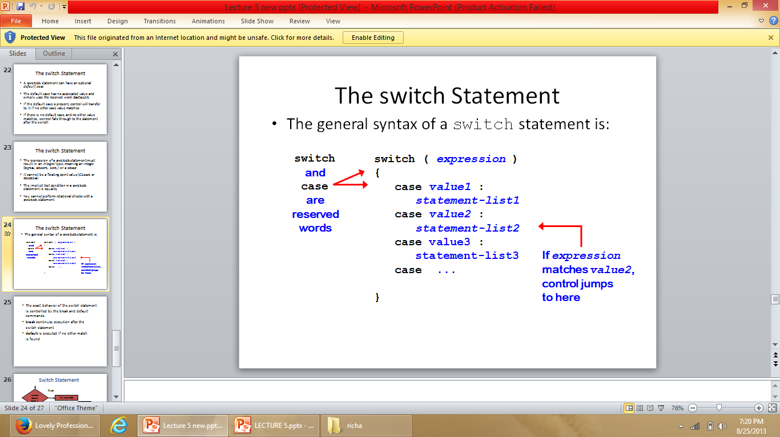
switch Statement
switch (expression)
{
case constant1:
statements;
break;
case constant2:
statements;
break;
case constant3:
statements;
break;
default:
statements;
}
Syntax

Slide 49
Rules of using switch case
Case label must be unique
Case label must end with colon
Case label must have constant expression
Case label must be of integer, character type like case 2, case 1+1, case ‘a’
Case label should not be floating point
Default can be placed anywhere in switch
Multiple cases cannot use same expression
Nesting of switch is allowed.
Variables are not allowed in switch case label..

Slide 50
Syntax error in switch statement
Variable cannot be used as label
switch(pt){
case count:
printf(“%d”, count);
break;
case 2.5:
printf(“A line”);
break;
case 3 + 7.7:
printf(“A triangle”);
case 3 + 7.7:
printf(“A triangle”);
break;
case count+5:
printf(“A pentagon”);
break;
}
Floating point number cannot be used
Floating point number cannot be used and same expression cannot be used
constant expression should be used

Slide 51
#include<stdio.h>
int main()
{
int pt;
printf("Enter the number of nodes:");
scanf("%d", &pt);
switch(pt){
case 0:
printf("\nNo Geometry");
break;
case 1:
printf("\nA point");
break;
case 2:
printf("\nA line");
break;
case 3:
printf("\nA triangle");
break;
case 4:
printf("\nA rectangle");
break;
case 5:
printf("\nA pentagon");
break;
default:
printf("Invalid input");
break;
}
return 0;
}
Program to show switch statement in geometry
Enter the number of nodes: 2
A line

Slide 52
Q1
#include <stdio.h>
int main()
{
double ch;
printf("enter a value between 1 to 2:");
scanf("%lf", &ch);
switch (ch)
{
case 1:
printf("1");
break;
case 2:
printf("2");
break;
}
return 0;
}
A. Compile time error
B. 1
C. 2
D. Nothing will be displayed

Slide 53
Q2
What will be the output of the following C code? (Assuming that we have entered the value 1 in the standard input)
#include <stdio.h>
int main()
{
int ch;
printf("enter a value between 1 to 2:");
scanf("%d", &ch);
switch (ch)
{
case 1:
printf("1 ");
default:
printf("2");
}
return 0;
}
A. 1
B. 2
C. 1 2
D. Compile time error

Slide 54
Q3
What will be the output of the following C code? (Assuming that we have entered the value 1 in the standard input)
#include <stdio.h>
int main()
{
int ch;
printf("enter a value between 1 to 2:");
scanf("%d", &ch);
switch (ch)
{
case 1:
printf("1 ");
printf("hi");
break;
default:
printf("2\n");
}
}
A. 1 hi
B. 2
C. hi
D. 1

Slide 55
Q4
What will be the output of the following C code?
#include <stdio.h>
int main()
{
int x = 97;
switch (x)
{
case 'a':
printf("yes ");
break;
case 97:
printf("no");
break;
}
}
A. yes
B. yes no
C. Duplicate case value error
D. Nothing will be displayed

Slide 56
Q5
What will be the output of the following C code?
#include <stdio.h>
int main()
{
int a = 1;
switch (a)
{
case a:
printf("Case A ");
default:
printf("Default");
}
return 0;
}
A. Output: Case A
B. Output: Default
C. Output: Case A Default
D. Compile time error

